Slide 1
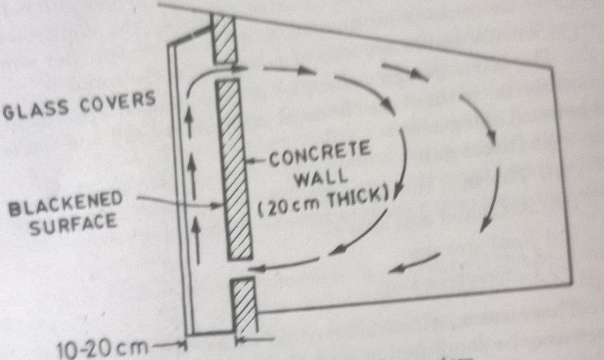
A passive solar heating system

Slide 2
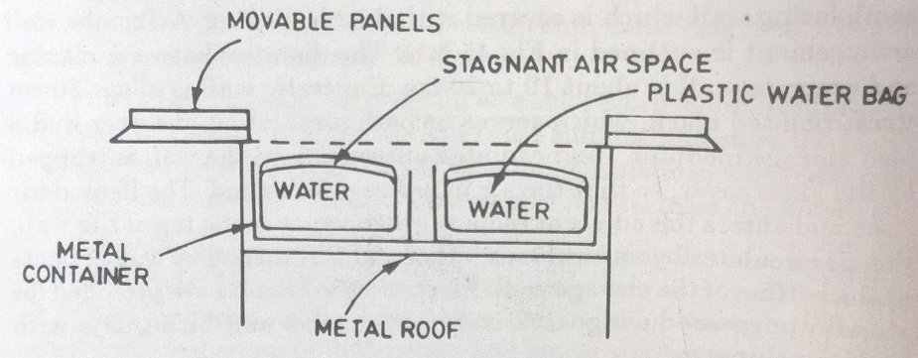
Roof storage of Solar Heat

Slide 3
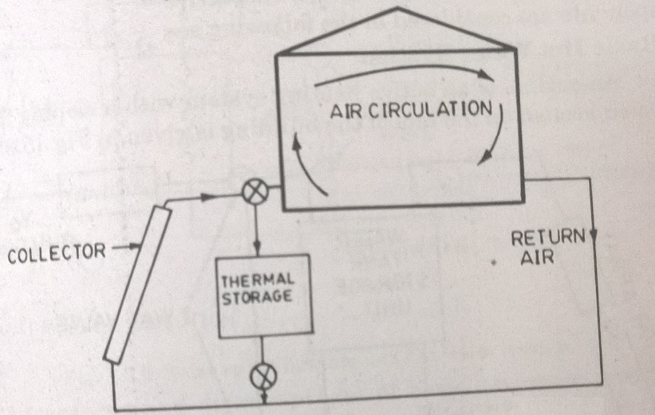
Convective loop passive solar heating

Slide 4
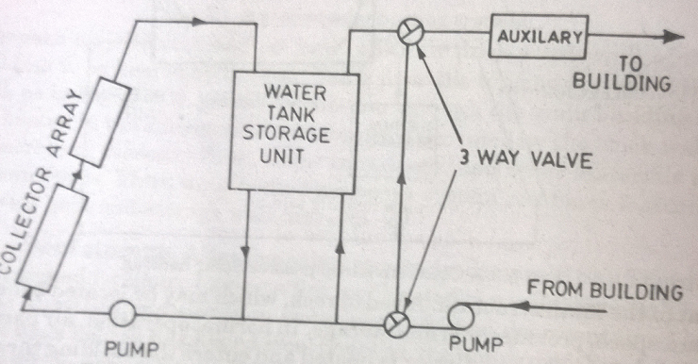
Basic hot water active system

Slide 5
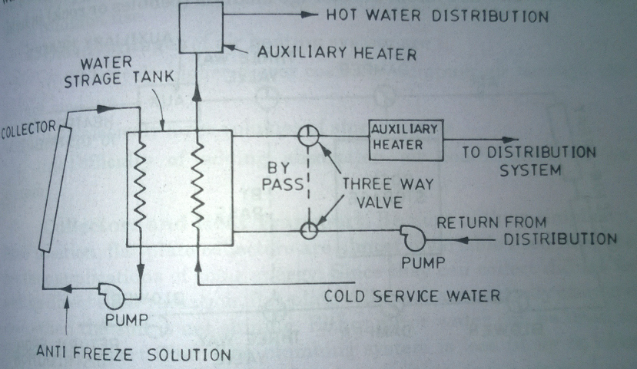
Solar space heating and hot water system

Slide 6
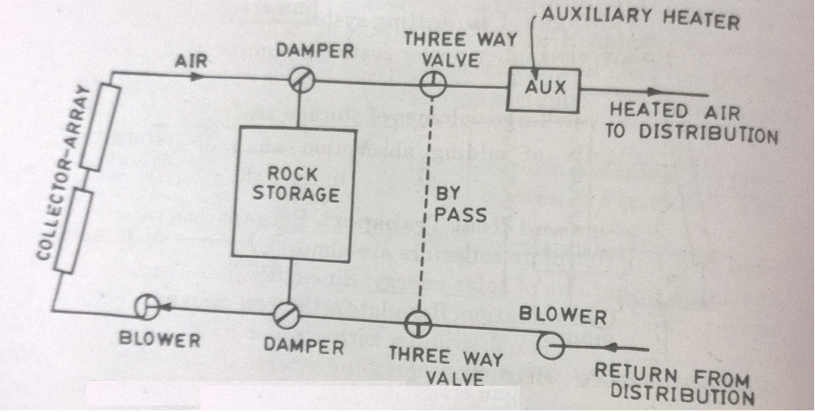
Basic hot air heating system

Slide 7
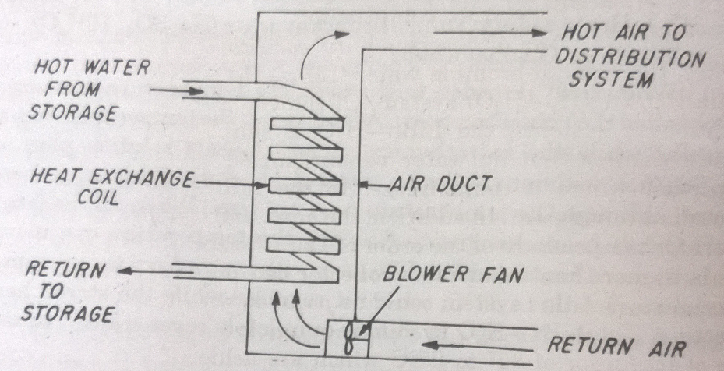
Water to air heating system

Slide 8
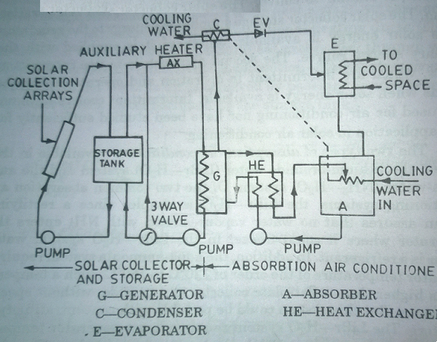
Solar operated absorption air conditioner

Slide 9
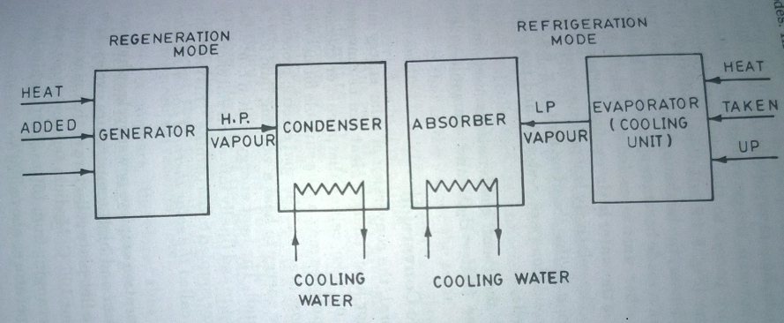

Intermittent absorption refrigerator

Slide 10
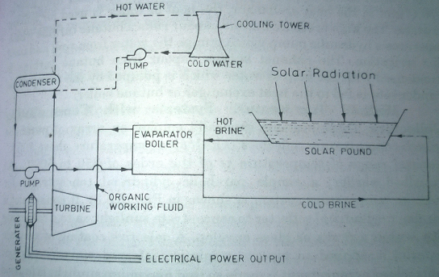
Solar pond electrical power plant

Slide 11
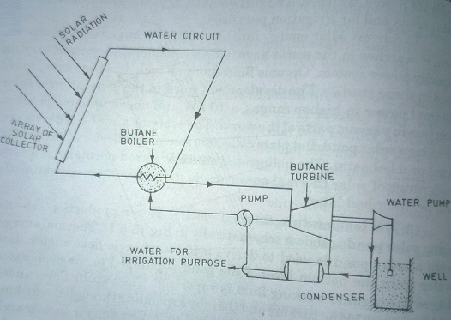
Low temperature solar power plant

Slide 12
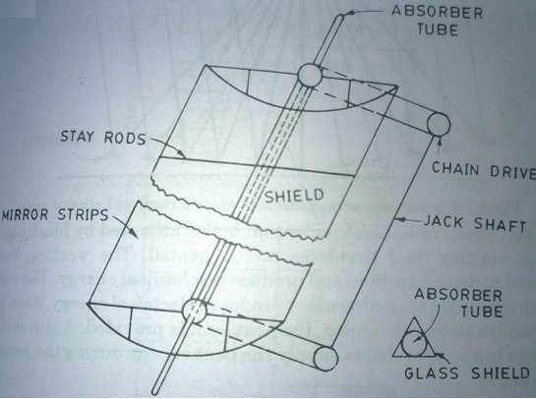
Typical parabolic cylindrical concentrator

Slide 13
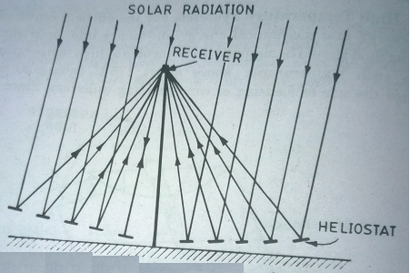
Central receiver heliostat array

Slide 14
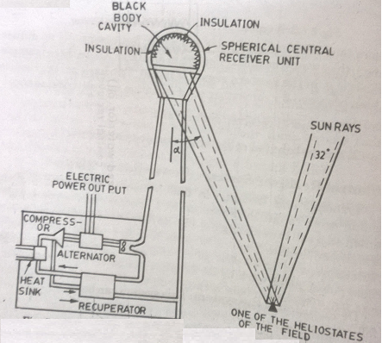
Central tower receiver associated with a field of flat mirrors and a gas turbine

Slide 15
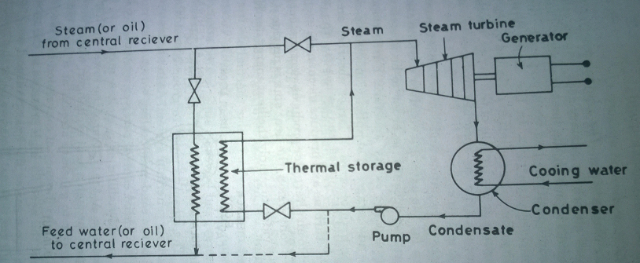
Electric power generation using thermal storage

Slide 16
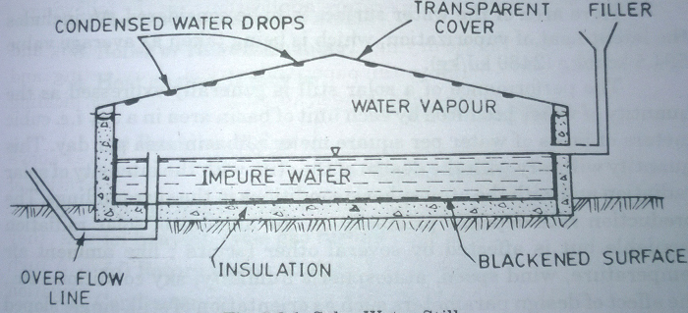
Solar water still or Distillation

Slide 17
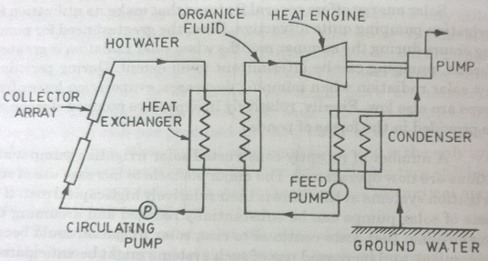
Solar pump

Slide 18
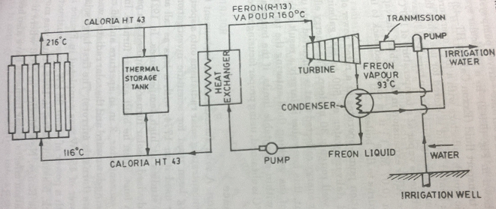
Turbine driven pump using solar energy

Slide 19

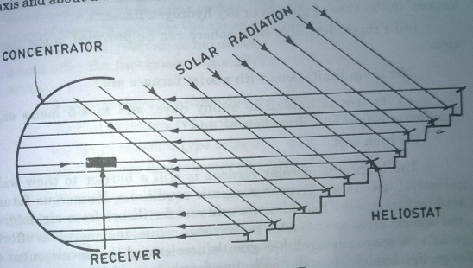
Principle of solar furnace

